Slide 1

Camunda 8 Self-Managed Deployment
Self Managed Deployment Use Cases
Notes:
Process Orchestration

Slide 2



Agenda:
Q & A
Sample use cases and case studies
Camunda Capabilities of Surge

Slide 3




Surge Technology Enhanced Mastery
Projects
Consultants
Industries
Geo
Banking
Telecom
Services
Retail
Manufacturing
Healthcare
North America
APAC
25+
125+
Camunda Certified Platinum Partner With Center of Excellence
Building
Re-usable components & Toolkits
Building strong teams with Realtime knowledge of industry challenges
Demonstratable scenarios for focused industries
Connectors & Templates
Finance, Telecom, Insurance, Healthcare, Utilities, Manufacturing
POC’s, MVP’s

Slide 4




ENABLING DIGITALTRANSFORMATION THROUGH
DESIGN | DEVELOPMENT | MANAGED SERVICES | BUSINESS & TECH CONSULTING
End to end capability from Ideation to Realization to Management with Innovation and Partnership
Camunda Application Development and Management | Business Process Management | Camunda Technology
Application/BPM Design and Development | Process Reengineering & Enhancement | Technology On Boarding & Tech landscape Integration
SDLC : SAFE, Agile, Scrum, Waterfall | Process Improvements & Agility | POC and MVP
DevOps | Kaizen | Architecture & Solution
Testing | Change Management | Infrastructure planning and sizing
Project and Program Management | Evangelize | DevSecOps
Multi-LOB Scaling, LOB Onboarding, with POD concept | Process & Portfolio Management | Managed Services, Application Management and Monitoring with ITIL
Our Accelerators, Templates and Premade Reusable Components Makes us Unique and Different from Others
4

Slide 5
Leading Financial and Wealth Management Organization
Why process orchestration?
Streamline internal process, faster response time.
Business challenges
Endpoint diversity - Spans across a number of possible process endpoints (people, systems, devices)
Easily integrate with most common technical architectures and frameworks
Frequent process sequence changes
Collect, aggregate, organize data from different applications, devices.
Collaborating with Legacy Systems to automate process
Adequate business rules changes.

Slide 6
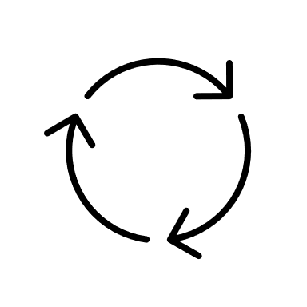
Leading Financial and Wealth Management Organization
Namespace : CamundaInfra
Namespace : Microservices
Namespace : App
TASKLIST
ELASTICSEARCH
MICROSERVICE 1
BROKER 1
APPLICATION 1
GATEWAY
Namespace : DB
POD 1
POD 6
POD 9
BROKER 2
OPERATE
MICROSERVICE 2
POD 13
DB
APPLICATION 2
POD 2
BROKER 3
POD 7
POD 10
OPTIMIZER
MICROSERVICE 3
POD 12
POD 14
POD 4
POD 3
POD 11
POD 5
POD 8
KUBERNETES
KUBERNETES CLUSTER

Slide 7
World’s Leading Manufacturer of construction and mining equipment
Why process orchestration?
End-to-End Orchestration
Business challenges
Make business Processes agile & configurable to suit business demands
Get unparalleled speed, scale and resilience.
Bring IT and the business together
10 % of static business key attributes are moved into configurable business rules (DMN)
& provided the flexibility to update business rules
Reduce total effort <30 hours until developer unit testing
Reusable components/ sub process can used across reports generation
Drag and drop custom connectors
Cost-Effective, horizontal scaling, Standards-based

Slide 8
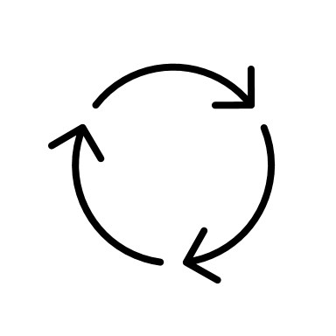
World’s Leading Manufacturer of construction and mining equipment
Namespace : workflow-engine
Namespace : app
Namespace : microservice
OPENSEARCH
BROKER 1
POD 4
MICROSERVICE 1
Namespace : db
AWS SQS CONNECTOR
GATEWAY
POD 1
BROKER 2
OPERATE
DB
POD 7
POD 9
POD 2
MICROSERVICE 2
BROKER 3
POD 6
POD 10
POD 3
POD 8
POD 5
KUBERNETES
KUBERNETES CLUSTER

Slide 9
Q & A

Slide 10
Appendix

Slide 11
Sample Sizing
No | System | vCPUs | Memory | Disk | Nodes | Remarks
1 | Zeebe Gateway | 16 | 32 | NA | Start with 1, Scale is needed. Default is 2 | Use compute optimized processors like Arm CPU or 3rd Gen AMD or Intel Processors
2 | Zeebe Brokers | 16 | 32 | 100GB | Start with 3, scale if needed | Use compute optimized processors like Arm CPU or 3rd Gen AMD or Intel Processors SSD disk types provides better IO Start with 5 partition with 3 broker / nodes Based on experience, we would need 7 brokers with 12 partition. We need to do performance test and scale from 3 as needed
3 | Workers | 16 | 32 | NA | Start with 2, scale if needed
4 | Elastic Search | 16 | 32 | 250GB |  | Retentions period Operate 30 to 90 days Optimize: is it needed, 6 to 18 months
5 | Prometheus and Grafana | 16 | 32 | 100GB

Slide 12
Sample Sizing
Microservices/ APIs response time should meet the below SLA to achieve Optimal end to end response time
No | Process Name | Max service Calls (A) | Zeebe Overhead by task (B) | Total overhead per transaction (A*B) | Expected Response time per service | Total service response time (B) | Exp Service Time (C) | Max Transaction Response Time (A+B+C)
1 | Workflow 1 | 9 | 60-100ms | .54 -> .9 secs | 100-150ms | .9 ->1.35 secs | 100ms | 2.35 secs
2 | Workflow 2 | 5 | 60-100ms | .3 -> .5 secs | 100-150ms | .5 ->.75 secs | 100ms | 1.35 secs
3 | Workflow 3 | 4 | 60-100ms | .24 -> .4 secs | 100-150ms | .4 ->.6 secs | 100ms | 1.1 secs

Slide 13
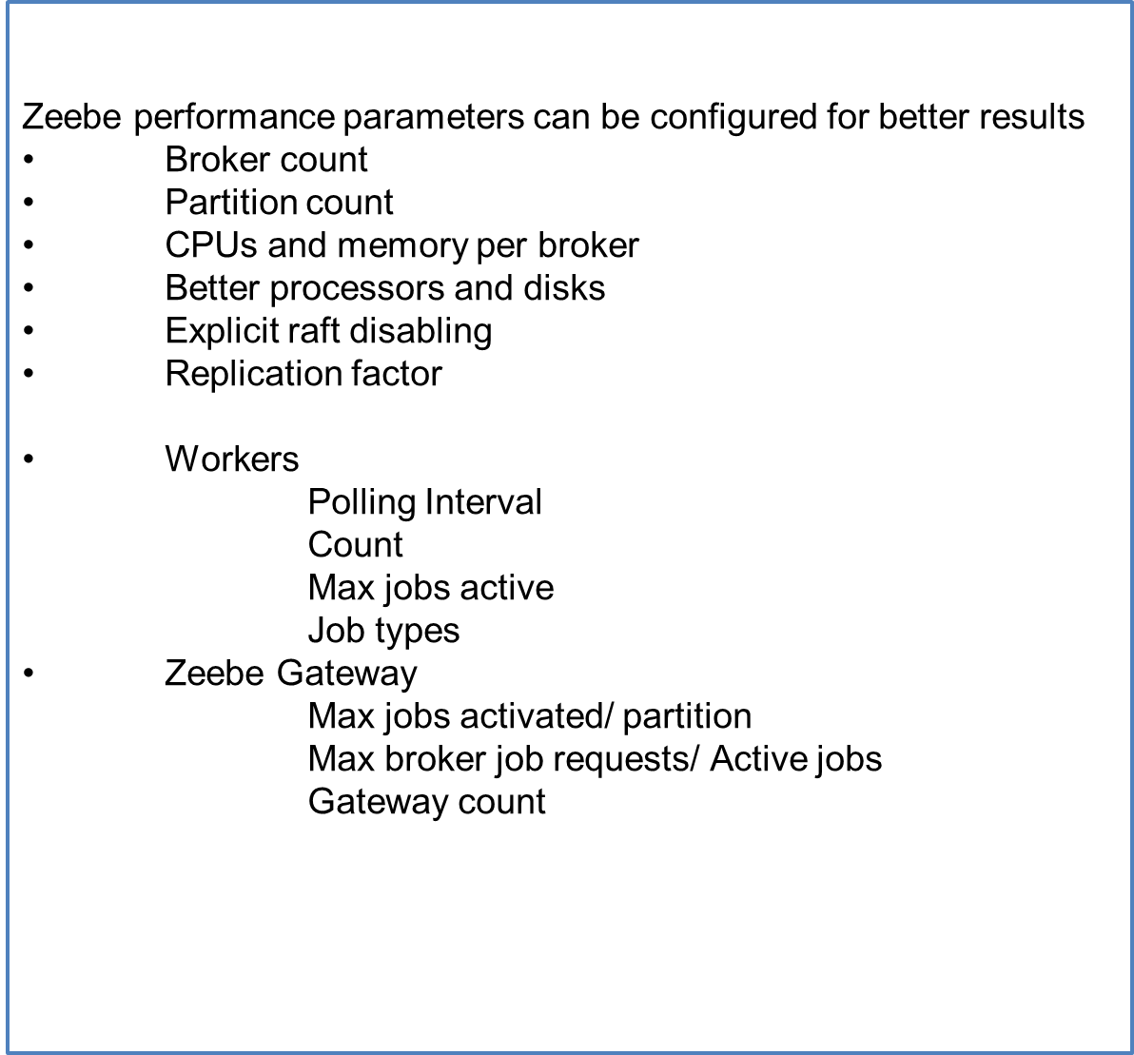
Sample Config

Slide 14
Thank You

